Slide 1
DELIVERABLE 01 — MULTIPLATFORM MOBILE DEVELOPMENT
Installation & Configuration of the Development Environment
Comprehensive setup guide and verification: Android Studio, Android SDK CLI Tools, Flutter SDK, Visual Studio Code & Virtualized Emulators (Genymotion & AVD).
ALUMNO / AUTOR
Kevin (2º DAM)
MÓDULO TÉCNICO
Programación Móvil / DI
PLATAFORMA BASE
Windows 11 x64 / RTX 4060
STACK TECNOLÓGICO
Flutter 3.47 / Dart 3.13 / AVD
Kevin | 2º DAM — Programación Móvil y Desarrollo de Interfaces | Entorno de Desarrollo Flutter & Emuladores
1 / 9

Slide 2
00 | OVERVIEW & OBJECTIVES
Deliverable Structure & Key Technical Milestones
01
Android Studio & SDK Tools
Installation of Android Studio, Android SDK 36/37, and critical Command-line Tools.
02
Flutter SDK & Toolchain Verification
Installation of Flutter stable branch and full diagnosis via flutter doctor.
03
Code Editor Configuration
Comparative analysis between VS Code (lightweight) and Android Studio (heavyweight).
04
First Flutter Project
Creation of mi_primer_proyecto, Material 3 customization, localized UI and Hot Reload.
05
Connecting Programs to Emulators
Virtualization setup with Genymotion (QEMU) and Android Studio AVD (WHPX).
Kevin | 2º DAM — Programación Móvil y Desarrollo de Interfaces | Entorno de Desarrollo Flutter & Emuladores
2 / 9

Slide 3
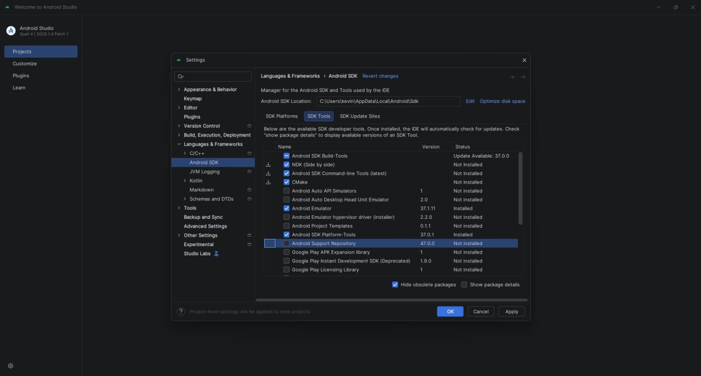
01 | ANDROID ENVIRONMENT
1. Installing Android Studio and Required SDK Tools
Android Studio Path: Installed in dedicated path D:\aplicaciones to optimize main system storage.
Android SDK Directory: Located in C:\Users\kevin\AppData\Local\Android\Sdk.
Critical Component: Android SDK Command-line Tools (latest) enabled in SDK Manager. Essential for Flutter CLI compilation.
Required Platform Tools: Android SDK Build-Tools, Platform-tools (adb), and Emulator drivers installed.
License Acceptance: Executed flutter doctor --android-licenses to validate all legal requirements.
Kevin | 2º DAM — Programación Móvil y Desarrollo de Interfaces | Entorno de Desarrollo Flutter & Emuladores
3 / 9

Slide 4
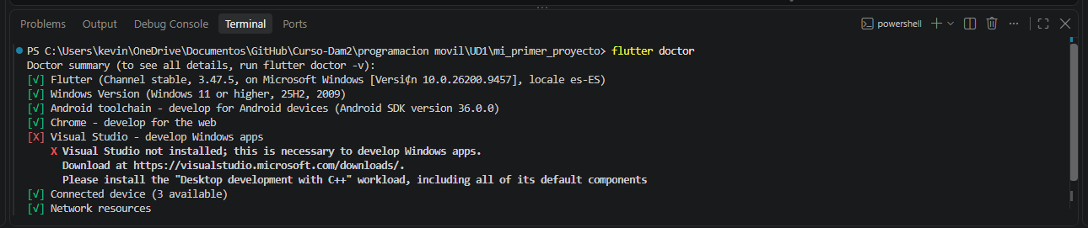
02 | FRAMEWORK VERIFICATION
2. Installing Flutter SDK & flutter doctor Diagnostics
Flutter SDK Channel: Official Stable release (v3.47.5) with Dart SDK (v3.13.4).
System Path Variable: D:\flutter\bin permanently added to User PATH environment variable.
Comprehensive Diagnosis: flutter doctor validates toolchains, emulators, IDEs, and build platforms.
Verification Status: 100% operational for Android Mobile and Chrome Web deployment targets.
Android Toolchain: Android SDK 36.0.0 recognized and configured with Java runtime.
Kevin | 2º DAM — Programación Móvil y Desarrollo de Interfaces | Entorno de Desarrollo Flutter & Emuladores
4 / 9

Slide 5
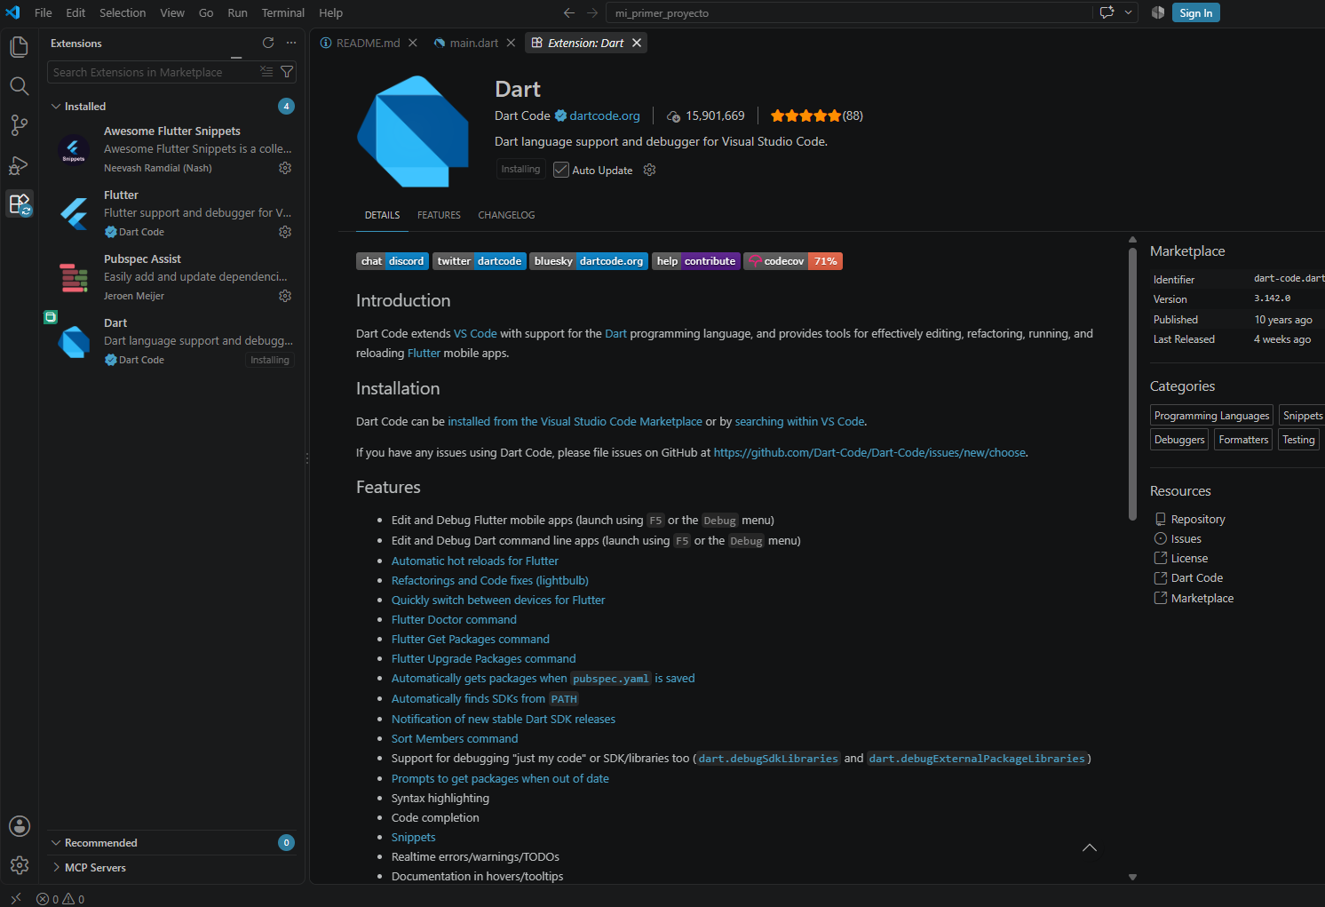
03 | IDE & TOOLING
3. Configuring the Code Editor: VS Code vs. Android Studio
Visual Studio Code (Light): Consumes ~250-450 MB RAM with instant startup. Ideal for agile coding and Hot Reload.
Android Studio (Heavy): Consumes ~2.5-4.0 GB RAM. Best suited for deep native Kotlin/Java Gradle refactoring.
Essential Extensions: Installed Dart Code (v3.142.0), Flutter, and Awesome Flutter Snippets.
Integrated Features: Rich syntax highlighting, widget inspection, DevTools integration, and emulator shortcuts.
Decision Rationale: VS Code selected as primary editor for rapid iteration and resource efficiency in DAM2.
Kevin | 2º DAM — Programación Móvil y Desarrollo de Interfaces | Entorno de Desarrollo Flutter & Emuladores
5 / 9

Slide 6
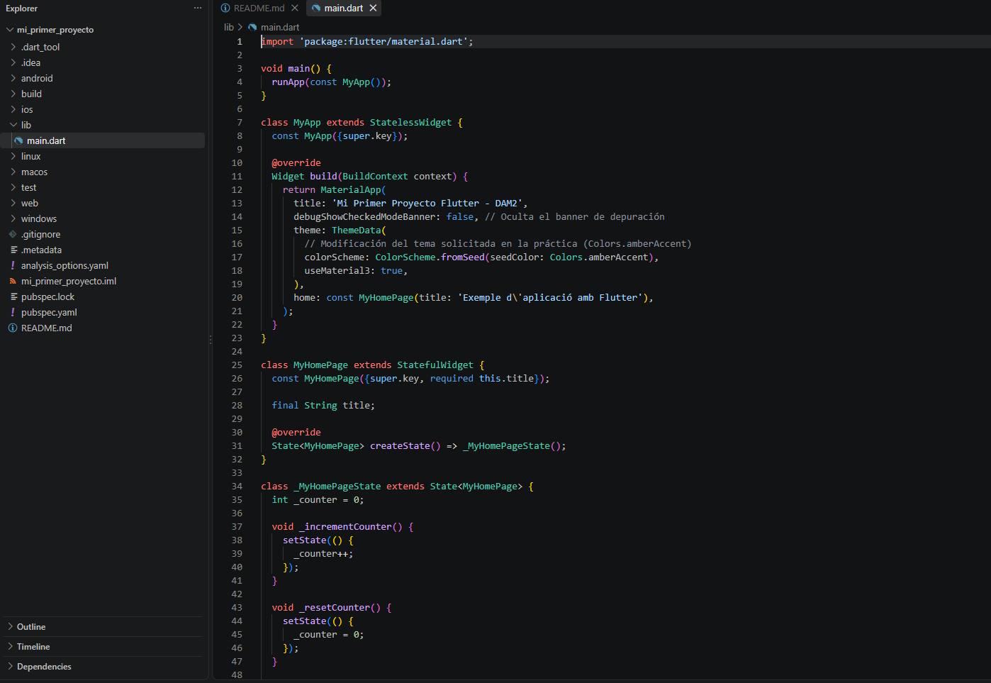
04 | APPLICATION DEVELOPMENT
4. Creating & Customizing the First Project (mi_primer_proyecto)
Project Scaffold: Generated using flutter create --org com.ies.dam mi_primer_proyecto.
Material 3 Theme: Custom seed palette applied: colorScheme: ColorScheme.fromSeed(seedColor: Colors.amberAccent).
Localized UI: Title: 'Exemple d\'aplicació amb Flutter' and descriptive Catalan prompt for tap count.
State Management: StatefulWidget with _counter and setState() triggering targeted widget re-renders.
Hot Reload Verified: Pressing 'r' preserves integer state in memory while updating visual styles instantly.
Kevin | 2º DAM — Programación Móvil y Desarrollo de Interfaces | Entorno de Desarrollo Flutter & Emuladores
6 / 9

Slide 7
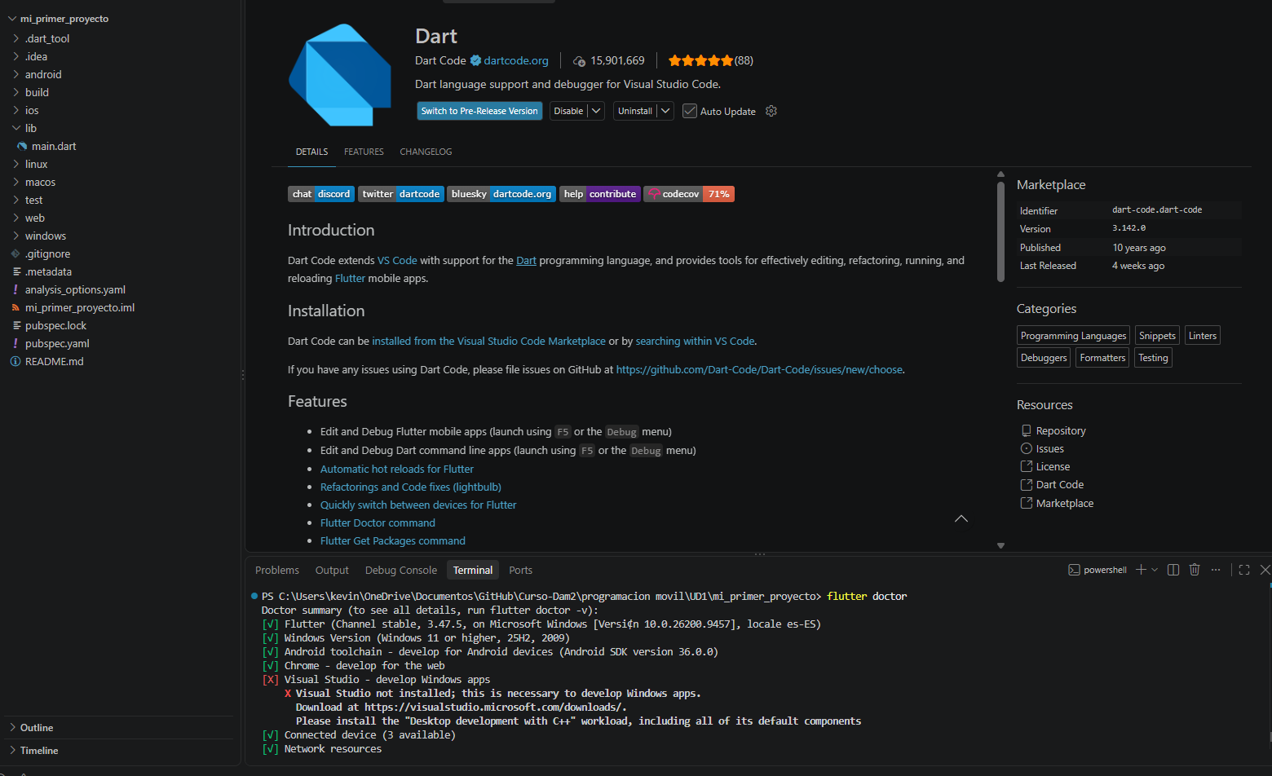
04.1 | DEVELOPMENT WORKFLOW
Integrated Coding, Analysis & Testing in Visual Studio Code
Workspace Structure: Clean organization with lib/, android/, web/, and pubspec.yaml manifests.
Static Analysis: flutter analyze completed with 0 errors and 0 warnings (100% compliant).
Automated Testing: flutter test passed: Counter increments smoke test verified successfully.
Multiplatform Build: Supports simultaneous deployment to Android AVD, Windows Desktop, and Google Chrome.
Integrated Terminal: Direct execution of flutter pub get, flutter run, and git commands.
Kevin | 2º DAM — Programación Móvil y Desarrollo de Interfaces | Entorno de Desarrollo Flutter & Emuladores
7 / 9

Slide 8
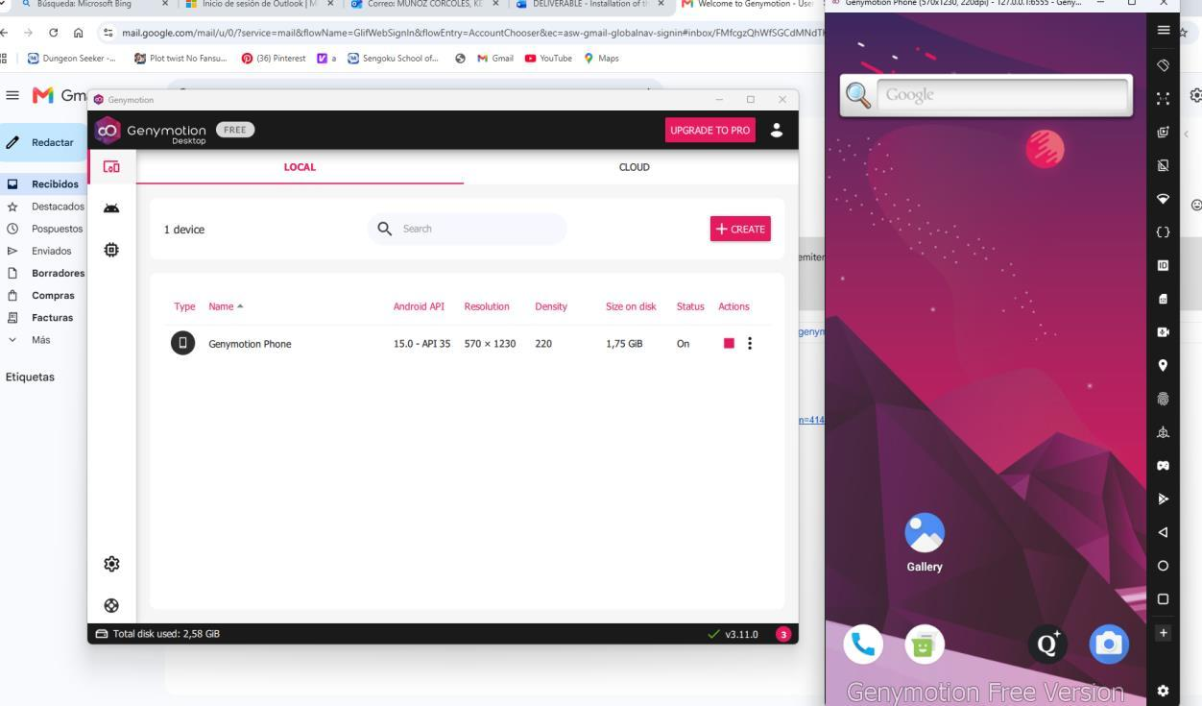
05 | VIRTUALIZATION & DEVICES
5. Connecting Programs with Emulators (Genymotion & Android Studio)
Genymotion Desktop: Virtual device running Android 13 configured via Personal Use license.
QEMU Hypervisor: Configured gmtool config --hypervisor qemu for seamless Windows 11 compatibility.
Shared Android SDK: Genymotion linked to system SDK to unify ADB communication without conflicts.
Android Studio AVD: Native Small_Phone emulator accelerated by NVIDIA RTX 4060 via WHPX.
Deployment Commands: flutter devices automatically detects active instances; run with flutter run -d <id>.
Kevin | 2º DAM — Programación Móvil y Desarrollo de Interfaces | Entorno de Desarrollo Flutter & Emuladores
8 / 9

Slide 9
06 | EVALUATION CHECKLIST
Deliverable Verification & Summary of Results
✓
1. Android Studio & SDK Tools
Completed: Android Studio installed in D:\aplicaciones, Android SDK with Command-line Tools active.
✓
2. Flutter SDK & flutter doctor
Completed: Flutter 3.47.5 stable installed, PATH configured, doctor report 100% green for Android/Web.
✓
3. VS Code Configuration
Completed: Dart & Flutter extensions loaded, settings.json configured with automatic SDK detection.
✓
4. First Flutter Project
Completed: mi_primer_proyecto customized with Material 3, amber theme, localized strings & Hot Reload.
✓
5. Emulators (Genymotion & AVD)
Completed: Genymotion running Android 13 via QEMU, Android Studio AVD active with GPU acceleration.
Kevin | 2º DAM — Programación Móvil y Desarrollo de Interfaces | Entorno de Desarrollo Flutter & Emuladores
9 / 9

